Slide 1

Churchwardens’ Training Day
Welcome

Slide 2
Churchwardens as leaders

Slide 3
Churchwardens as leaders
Canon E1, Of Churchwardens:
The churchwardens when admitted are officers of the bishop. They shall discharge such duties as are by law and custom assigned to them; they shall be foremost in representing the laity and in co-operating with the incumbent; they shall use their best endeavours by example and precept to encourage the parishioners in the practice of true religion and to promote unity and peace among them. They shall also maintain order and decency in the church and churchyard, especially during the time of divine service.

Slide 4
Churchwardens as leaders
Canon E1, Of Churchwardens:
The churchwardens when admitted are officers of the bishop. They shall discharge such duties as are by law and custom assigned to them; they shall be foremost in representing the laity and in co-operating with the incumbent; they shall use their best endeavours by example and precept to encourage the parishioners in the practice of true religion and to promote unity and peace among them. They shall also maintain order and decency in the church and churchyard, especially during the time of divine service.

Slide 5
Churchwardens as leaders
Canon E1, Of Churchwardens:
The churchwardens when admitted are officers of the bishop. They shall discharge such duties as are by law and custom assigned to them; they shall be foremost in representing the laity and in co-operating with the incumbent; they shall use their best endeavours by example and precept to encourage the parishioners in the practice of true religion and to promote unity and peace among them. They shall also maintain order and decency in the church and churchyard, especially during the time of divine service.

Slide 6
Churchwardens as leaders
Canon E1, Of Churchwardens:
The churchwardens when admitted are officers of the bishop. They shall discharge such duties as are by law and custom assigned to them; they shall be foremost in representing the laity and in co-operating with the incumbent; they shall use their best endeavours by example and precept to encourage the parishioners in the practice of true religion and to promote unity and peace among them. They shall also maintain order and decency in the church and churchyard, especially during the time of divine service.

Slide 7
Churchwardens as leaders
Canon E1, Of Churchwardens:
The churchwardens when admitted are officers of the bishop. They shall discharge such duties as are by law and custom assigned to them; they shall be foremost in representing the laity and in co-operating with the incumbent; they shall use their best endeavours by example and precept to encourage the parishioners in the practice of true religion and to promote unity and peace among them. They shall also maintain order and decency in the church and churchyard, especially during the time of divine service.

Slide 8
Churchwardens as leaders
Influence and culture
All wardens are chosen for the role by their church, and given authority to carry it out on behalf of the Bishop.
Being a churchwarden gives you influence in your church. What you think, the way you go about your business, what you prioritise, matters.
In the way you act as churchwarden, you will shape your church’s culture.

Slide 9
Churchwardens as leaders
Caring for the clergy
a safe environment in which to live and minister
sufficient time off for rest, recreation and proper holidays
an annual opportunity to make a retreat of at least a week’s duration in addition to holidays
adequate administrative assistance
reimbursement in full of ministerial expenses [in line with national guidance]
appropriate release for extra-parochial ministry
prayer and pastoral support from those who work most closely with them.

Slide 10
Churchwardens as leaders
Other areas:
Ex-officio member of the PCC
Oversight of the activities of the church
Involvement in services
Specific responsibilities relating to the church building
Safeguarding
Dealing with the unexpected
Vacancies

Slide 11
Churchwardens as leaders
Good Practice
Regular meetings with the minister. Good (supportive and honest) communication is essential.
Churchwardens must sometimes represent the congregation to the minister, and the minister to the congregation.
Disagreeing with the minister in private and supporting them in public is often wise.
Delegation might take more work for you and the task might be done less well, but it is essential.

Slide 12
Churchwardens as leaders
Where can you ask for help?
Other churchwardens
Area Deans
Archdeacons
Registry
Diocesan Staff
Online resources

Slide 14
Faculties and the Church Buildings Team

Slide 15
This session began with the video recorded by the Registrar

Slide 16
What do you need to know?
You do not need to memorise all of the rules, but there are some key points to remember:
Changes to your church building or its contents require permission (even if they are ‘temporary’).
List A is a list of minor types of work where permission is pre-granted. List B is a list of somewhat less-minor types of work where permission can be given by the Archdeacon, which is a shorter process.
Anything which isn’t on List A or List B requires permission from the Diocesan Chancellor, known as a faculty.

Slide 17
What do you need to know?
Getting a faculty starts with an application, which goes to a committee called the DAC.
The DAC will sometimes need quite a lot of detail.
They exist to help churches follow the law, not to prevent work being done!
Particularly with large projects, talking to them at an early stage can be enormously helpful.

Slide 18
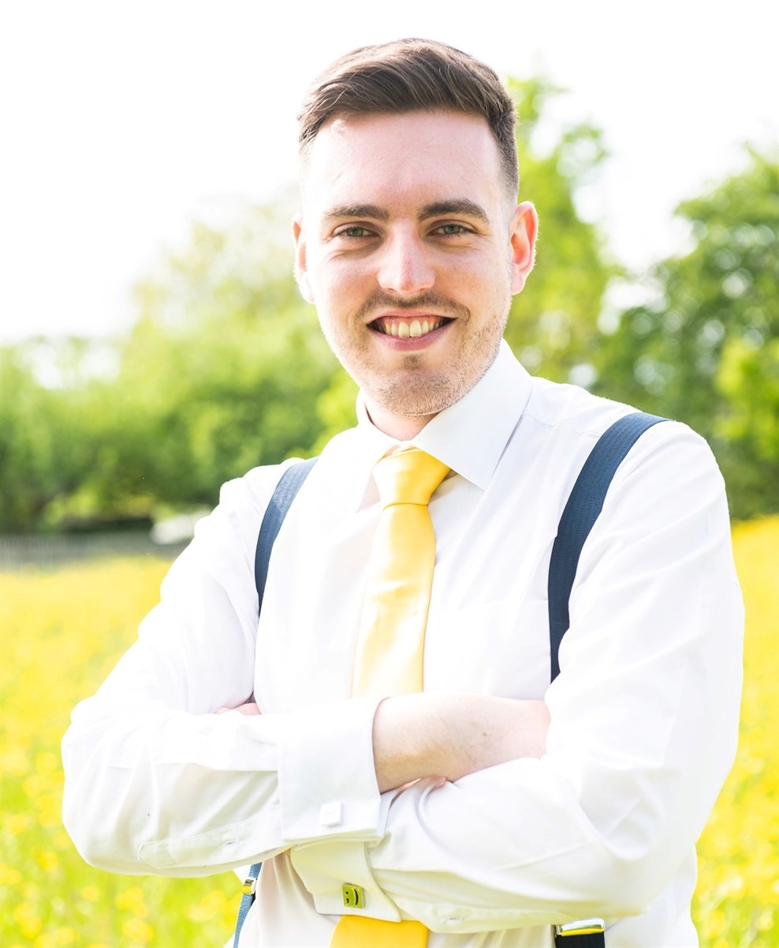
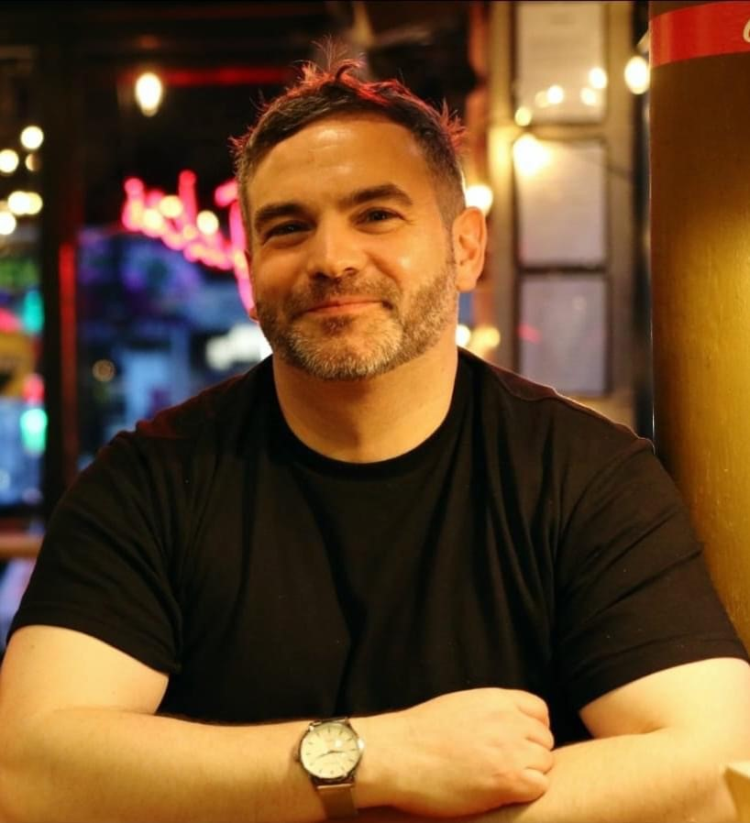
Church Buildings Team
Tim Latham
DAC Secretary
Mark Seabourne
Assistant DAC Secretary

Slide 19
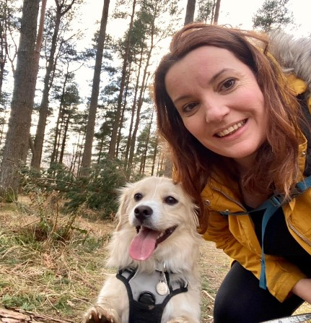

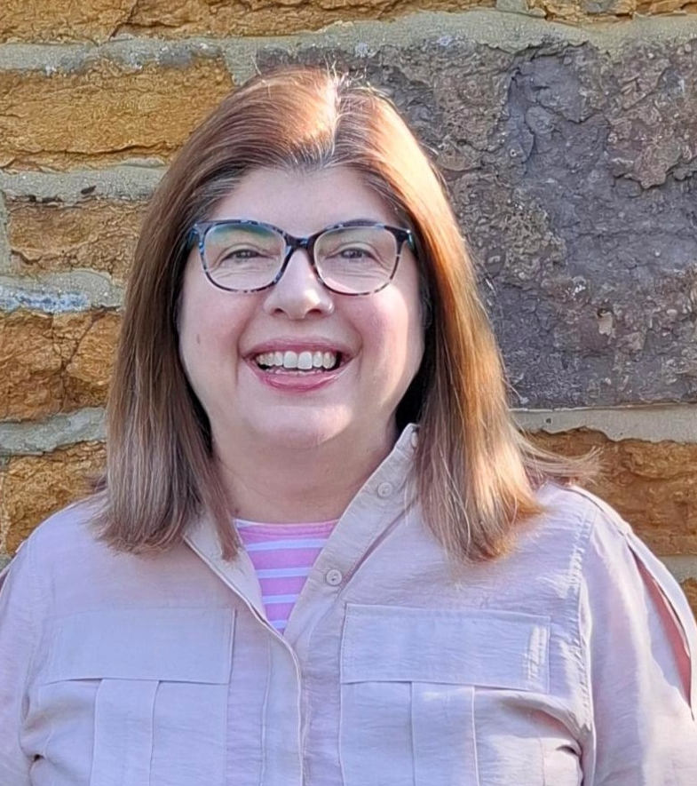
Church Buildings Team
Claire Strachan
Church Buildings Development Officer
Andy Duncan
Church Buildings Funding Support Officer
Julie Nottingham
Church Building Support Officer

Slide 21

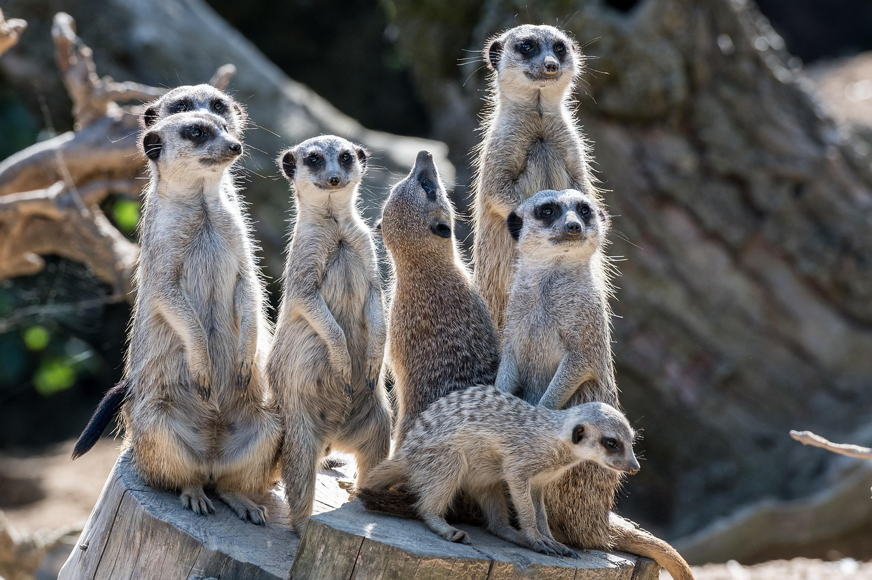
The Big Picture
Our most valuable resource is people’s time and energy – and some of that must go into keeping an eye on the big picture, not just the immediate tasks.
If we imagine churches as pot plants, we are called to throw ourselves into the life of the plant, be as good a pot as possible, and share the work of the gardener, having a detached view and making decisions for the overall good of the life we want to grow.
The next slide is a worked example….

Slide 22
How well does your church attract new members?
Your core or worshipping church community
Many different activities bring people into contact with your church, e.g. concerts, food banks (often as a side effect of the main purpose).
The community your church is in
For people to move from ‘having contact’ to ‘church member’ usually requires building relationships, trust, and spiritual input and often takes some time. Enquirers courses can be a helpful part of this.
People in your community in contact with your church
Does your church have positive contact with your community? And do you create spaces and opportunities for getting to know people well and for conversations about faith?

Slide 24
Boundaries
Why do we need them?
What are they?
Where are yours?
How do we keep them?

Slide 26
Approaching the future
What do you love about your church?
What are your hopes, dreams or desires for the future of your church?

Slide 27
Approaching the future
Clouds and ladders
Cloud: the hopes, dreams or desires for the future of your church and its relationships with your community.
Ladder: how are you going to get there? How does that future connect with what your church is currently doing?

Slide 28
Approaching the future
Clouds and ladders
Does your church have a vision statement or similar?
If it does, how does it guide your decision making?

Slide 29
Approaching the future
Pointers and pitfalls
Pitfalls:
Why think about the future?
Act before you have to.
Pruning is difficult.
Pointers:
- Ask for help. Outside perspective can be really useful.
- Create space for creativity
- “Ok, but what can we do?”

Slide 30
Approaching the future
Is there anything from this session which applies to your church?

