Slide 1


Candidate Recruitment Pack
Insert PCC/Parish Logo

Slide 2
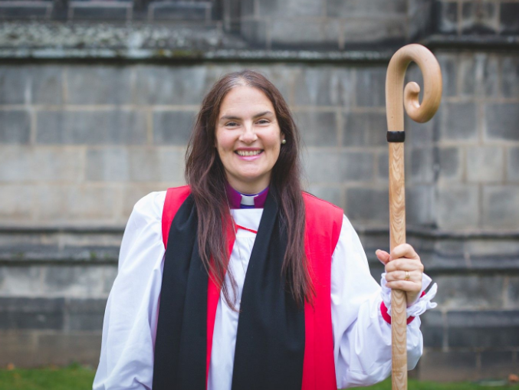
About the Diocese of Coventry
The Diocese of Coventry represents the Church of England in Coventry, Warwickshire and part of Solihull.
With our network of over 200 parishes, we have a Christian presence in every local community.
We have a rich variety of people, traditions and organisations united by our shared purpose of worshipping God, making new disciples and transforming communities.
Bishop of Coventry
The Rt Revd Sophie Jelley

Slide 3
About the PCC/PARISH
INSERT INFORMATION ABOUT YOUR PARISH.

Slide 4
Note from the Vicar/Rector etc
INSERT A NOTE FROM THE VICAR ETC THANKING THE CANDIDATE FOR THEIR INTEREST IN YOUR PARISH

Slide 5

Equality, Diversity & Inclusion
We welcome Diversity in the Diocese of Coventry
We are dedicated to employing staff with diverse backgrounds, abilities and working styles.
We understand that a diversity of ability can involve a diversity of needs.
We are committed to actively supporting all staff members to fulfil their potential.
If you have a disability, long-term illness or are neurodivergent, and feel this prevents you from meeting any of the essential criteria, please contact us to discuss the adjustments we can make for you.
All employees undertake equality, diversity and inclusion training.

Slide 6
Our Values
If you have any organization/Church values you can add them here

Slide 7
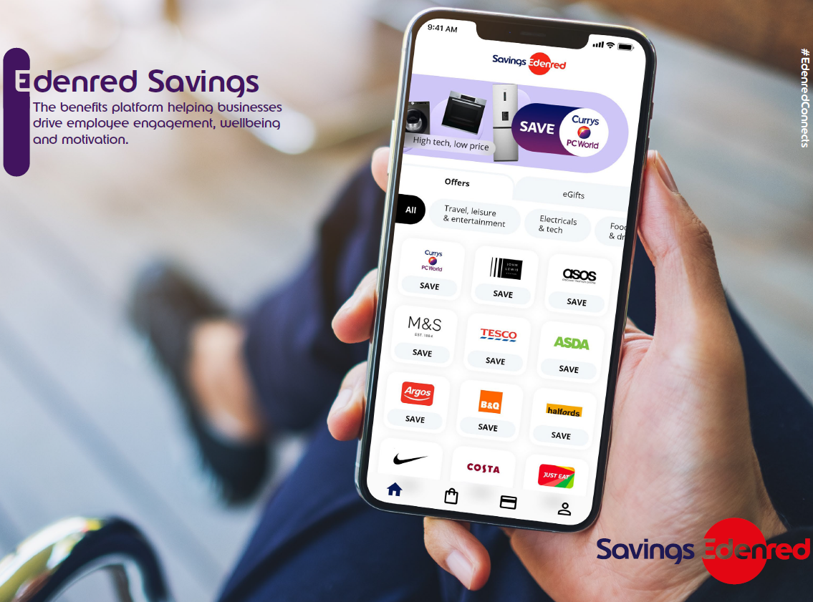

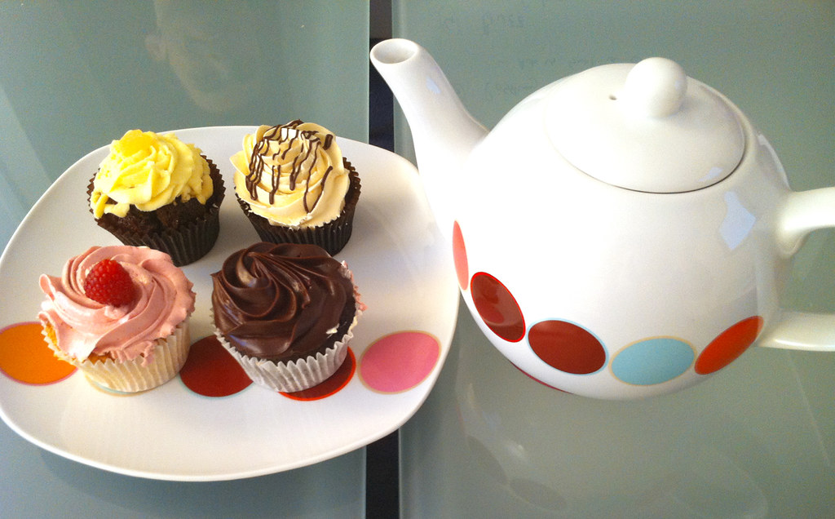

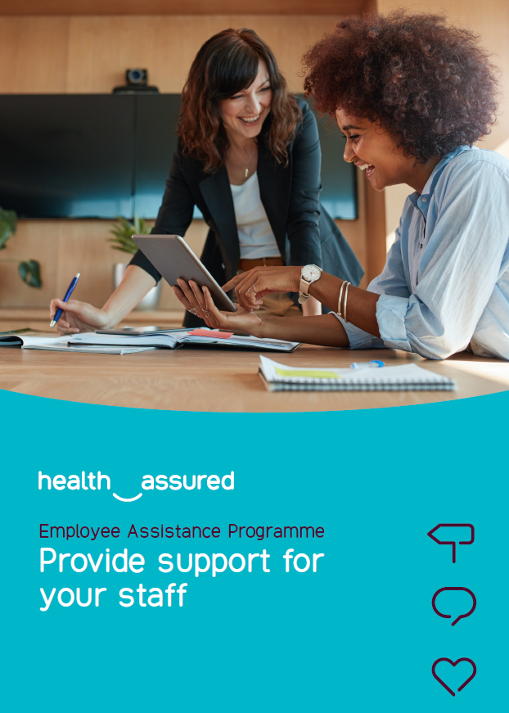





Employee Benefits

Slide 8
Our Benefits in Detail
Insert here any benefits you offer to your employees:
Generous salary in the Charity Sector
We pay, at a minimum, the Real Living Wage to all our employees
Pension Scheme with employer pension contributions of X%
Life Assurance of 2 x Salary
X days annual leave, plus bank holidays and an additional X days leave at Christmas
Enhanced Company Sick Pay, Maternity Pay, Paternity Pay and Adoption Pay
Positive approach to Mental Health and Wellbeing for all employees
Employee Assistance Programme, Mental Health Support and access to our Diocesan Counsellor
Reward and Recognition Package
Eye Care Vouchers
Training & Development
Free Bible study resources
Weekly Tea/Coffee Staff get togethers and other staff events

Slide 9

The Application form
Tips to maximise your success

Slide 10
How to complete our application form
When completing our application form, please make sure you complete all relevant sections in full.
Ensure that you check your spelling and that your email address and phone number are correct so that we can contact you.
Carefully read the Job advert, Job description and Person specification to enable you to answer any questions fully, to show how you meet the criteria for the role.
Most sections are self-explanatory, however the main sections that you will be scored against are below. (Please complete these in full, with the tasks you undertook, and expand on any tasks that are relevant to the role you are applying for):
  “Main duties and responsibilities” in the previous employers’ sections.
  “Describe your present employment in terms of responsibilities and relationships”
  “Give reasons why you think you would be suitable for this post giving evidence as to why you meet the criteria detailed in the person specification” (Please consider the tips on the next page with regard to completing this section).

Slide 11
Tips for showing you meet the criteria on the Person Specification
We understand that no-one is perfect, will meet 100% of the shortlisting criteria or score full points for each item on the essential criteria detailed on the person specification. We offer training and support to all our employees to ensure any gaps of knowledge are addressed so do not worry if there are some criteria that you only have limited experience of. The following points should help guide you when you complete your application form:
Don’t assume that we have knowledge of the situation/context that you are writing about.
Avoid using acronyms as we may not know what they mean.
Essential Criteria are key to the role and show what experience or qualifications you need to have familiarity with, in order to do the role, so please give as much detail as you can. It is the essential criteria that we use to score your application form, to decide if you will be accepted into the next phase of the recruitment process. Think about relevant examples from either your current job, a previous job, your personal life, community or any voluntary work that you undertake.
Desirable criteria are experiences/qualifications that are “nice to have” but are things that can be taught “on the job”. We do not usually score against the desirable criteria, unless all of the applicants scores are very close on the essential criteria. We would then use the desirable criteria as a secondary measure. If you do meet any of the desirable criteria, then please address them in the same way that you do for the essential criteria.
When addressing each item on the essential criteria, consider laying out your answer using the STAR technique as below:
S – Situation – what was the situation you were facing?
T – Task – What was it that you needed to do?
A – Action – How did you complete the task and why? (highlight only your contribution, not others)
R – Result – What was the outcome of your actions, what went well, and what did you learn?

Slide 12

Thank you for applying to work for us
If you have any questions, you can contact the RESPONSIBLE PERSON or Recruiting Manager whose details are written on the job advert.
We wish you every success with your application and thank you for your interest in our Parish.

