Slide 1
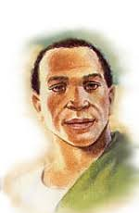
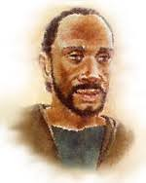
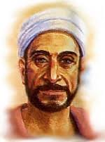
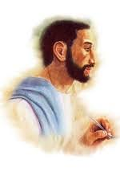
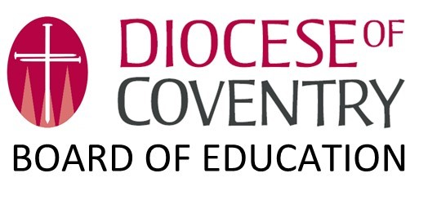
Telling The Story of Christianity Forwards
A Provocation in Readiness for Black History Month

Slide 2
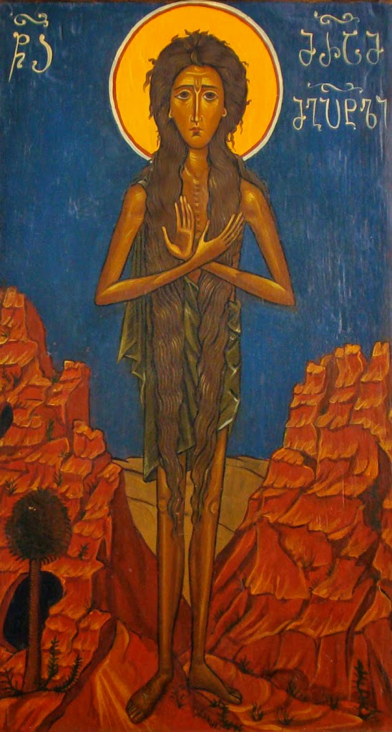
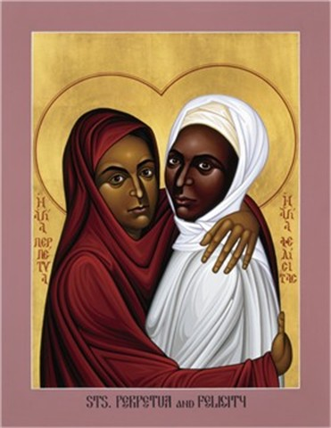
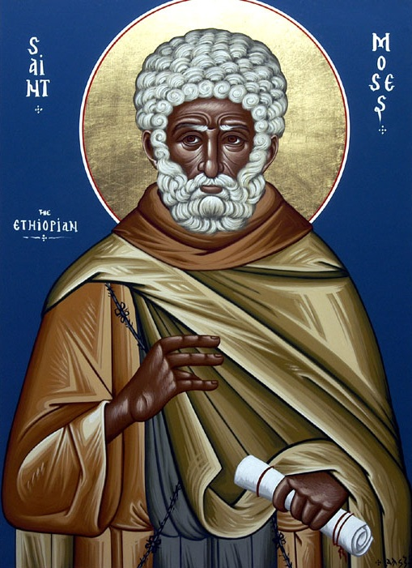
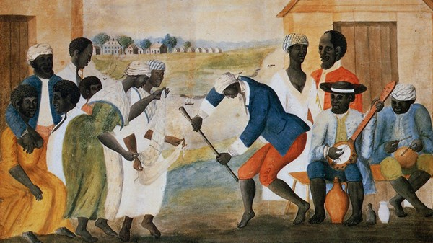
Reading the Story of Christianity Forwards
What are we missing?

Slide 3
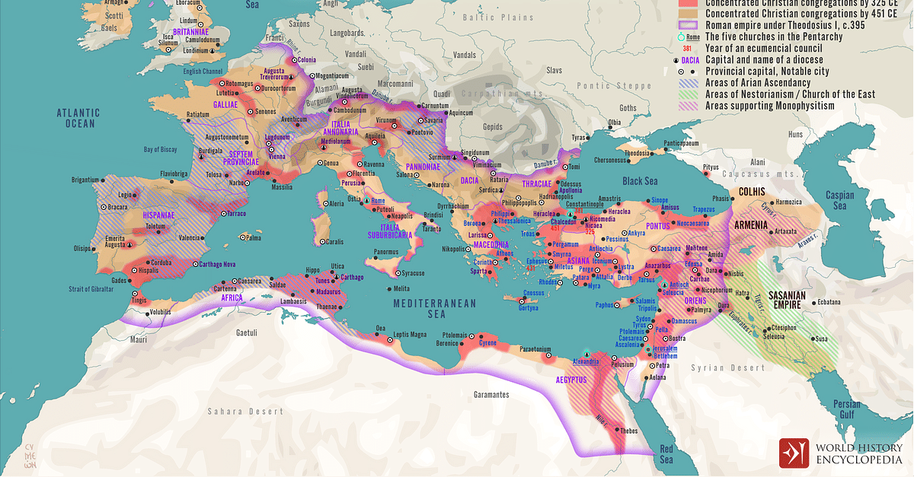

Slide 4
Early Church Fathers: Tertullian
Tertullian (160-225 CE) was born in Carthage, Tunisia.
He was an apologist; someone defending the Christian faith against both pagans and heretics through verbal defence and writings.
It was Tertullian who coined the term trinitas to describe the Godhead. He also adapted other Latin terms to explain that God eternally exists as one substance (substantia) in three distinct persons (personae).

Slide 5
Early Church Fathers: Origen
Born in Alexandria, Egypt, 185–254 CE
Origen was the first theologian to set out Christian doctrine in a systematic way.
He contributed to the Alexandrian school which was interpreting scripture allegorically and wrote extensive Bible commentaries
Origen also contributed to the development of the Trinitarian doctrine. He taught that the Son and the Spirit were distinguished from the Father but existed eternally with the Father. He also claimed that the Son is ‘eternally begotten’ of the Father, who is the arche (source) of the other two divine persons in the Trinity.

Slide 6
Early Church Fathers: Athanasius
Athanasius of Alexandria (296–373 CE) was an archdeacon and secretary to the bishop Alexander.
He rigorously defending the full divinity of Jesus Christ and his co-equality with God the Father, a position which is captured in his most influential work On the Incarnation.
To counteract the spread of the Arius’ doctrine (Arius was teaching that Jesus was a Creature and not fully divine), Athanasius argued that if Christ was not fully divine, he would have been unable to redeem humankind.
The council of Nicea in 325 CE affirmed that the Son was homoousias (meaning ‘of the same substance’) with God the Father, reinforcing the orthodox position that only God could save humankind.

Slide 7
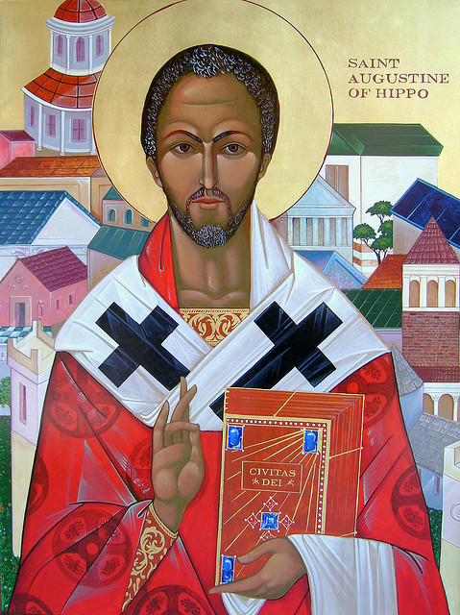
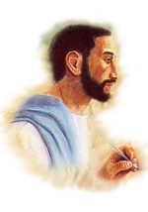
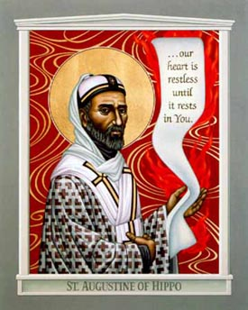
Early Church Fathers: Augustine of Hippo
Probably the most influential, and most recognised, of the North African Church Fathers is Augustine of Hippo (354-430 CE)
He was a massive single influence in shaping the entire Western Christian tradition throughout the Middle Ages.
A philosopher, bishop, and theologian, Augustine told the story of his life and his conversion to Christianity in the book Confessions (for some considered to be the first biography written in Western literature).
Another of his works, On the Trinity, further contributed to that doctrine.
In 391 CE he was ordained to the priesthood and a year later became bishop of Hippo, now Annaba, in Algeria, where he served as bishop until he died on August 28th 430 CE
His doctrine of original sin and grace shaped the entire Western Christian tradition.

Slide 8
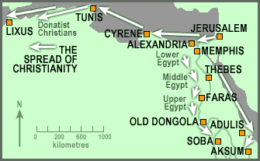
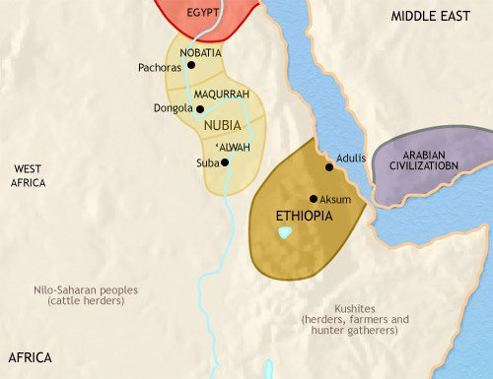
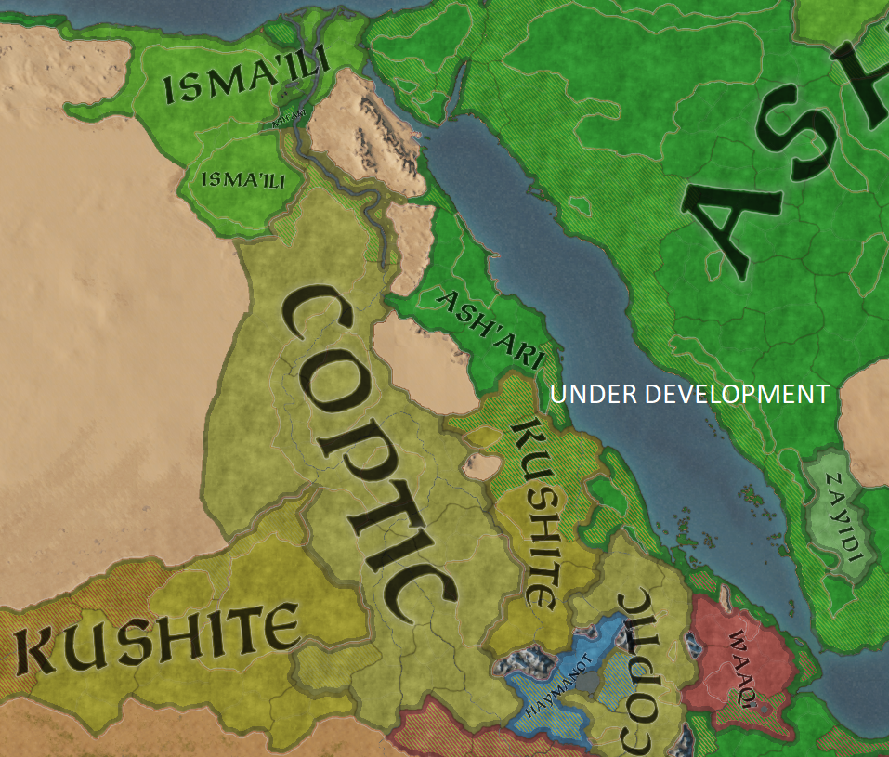
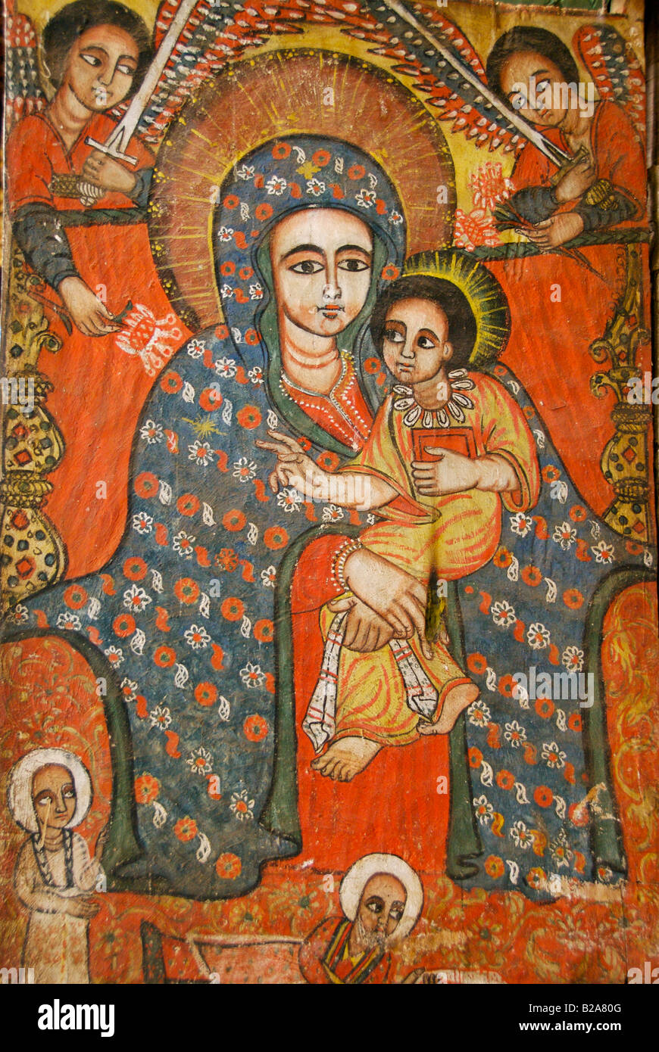
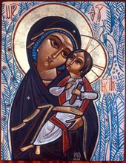
Spread of Christianity

Slide 9
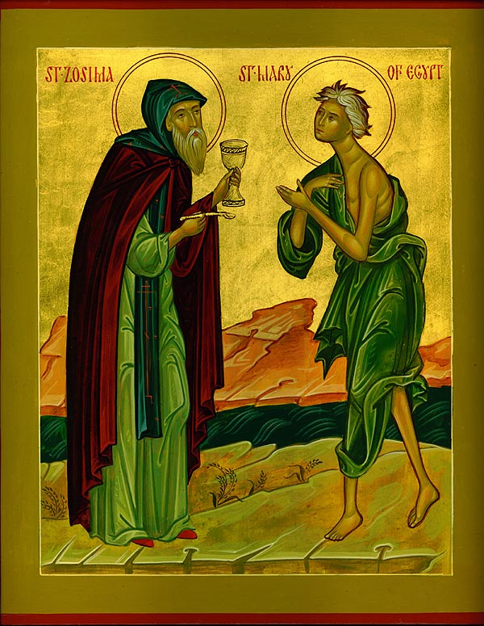
Mary of Egypt
344- 421 CE
Egyptian saint, highly venerated as a Desert Mother in the Eastern Orthodox and Coptic Churches
Life of promiscuity pre-conversion
‘Desert Mother’

Slide 10
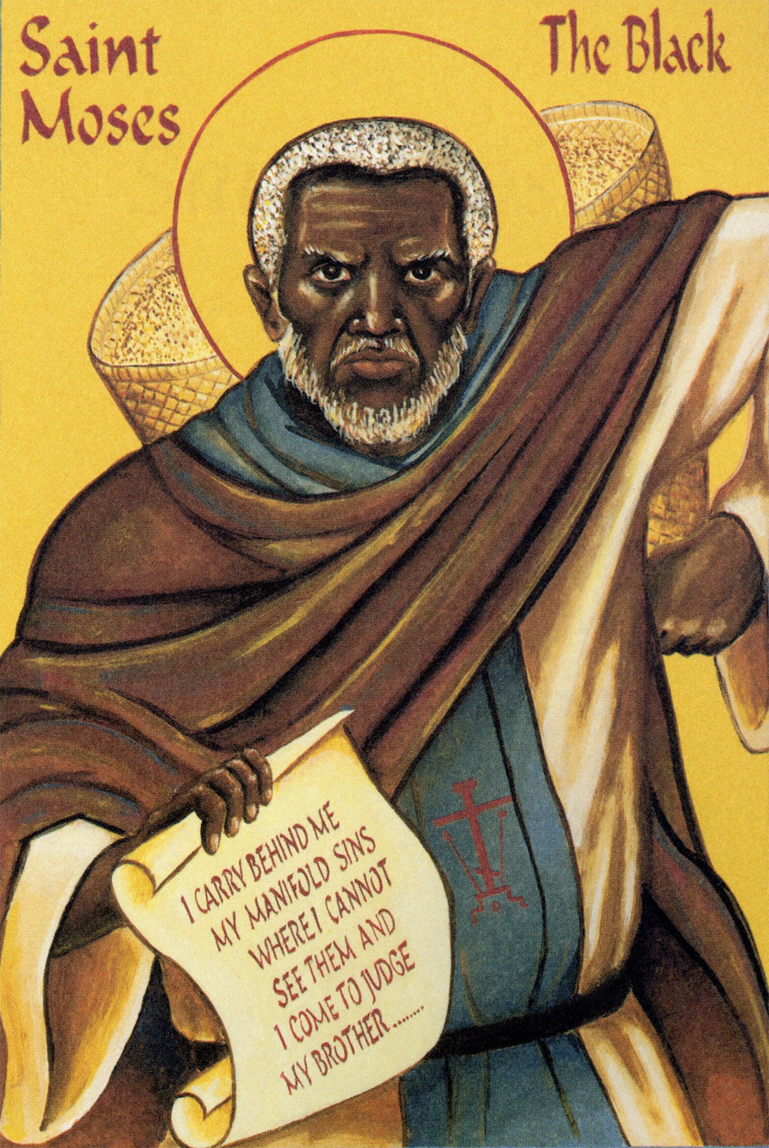
Moses the Black
330 (Ethiopia)- 405 (Egypt) CE
Abba Moses the Robber
Ascetic monk and priest in Egypt in the fourth highly venerated in both the Eastern Orthodox Church and the Oriental Orthodox Church
Life of crime and violence pre-conversion
‘Desert Father’
Patron of non-violence

Slide 11
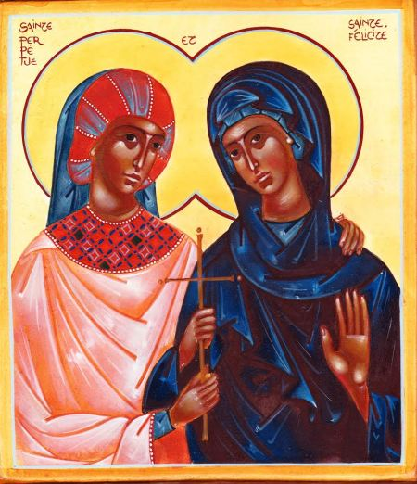
St Perpetua & St Felicity
182-203 CE North Africa
Martyr saints of third century, venerated in Eastern Orthodox, roman Catholic and Anglican traditions
Perpetua: recently married, well-educated noblewoman, said to have been 22 years old at the time of her death, and mother of an infant son she was nursing.
Felicity: enslaved woman imprisoned with Perpetua and pregnant at the time
Martyred together in the arena
Often included as patron of LGBTQ+ Christians due to demonstrated love for each other

Slide 12
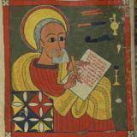
Zera Yacob
1599–1692 CE
Ethiopian philosopher from the city of Aksum (former capital of Ethiopia)
Developed a treatise around 1630 known in the original Ge'ez language as the Hatata (meaning Inquiry)It has been compared to René Descartes' Discours de la méthode (1637),although was written earlier.
Yacob argues in following one's natural reasoning instead of believing what one is told by others.
Living as a hermit for two years, praying and developing his philosophy, he had refused to adopt the Catholic faith (imposed by the current ruler) and instead fled into exile with some gold and the Book of Psalms. He lived many years in a cave.
Amongst other things, the Hatata contains:
Cosmological argument for God
Religious critique of slavery
“I have learnt more while living alone in a cave than when I was living with scholars. What I wrote in this book is very little; but in my cave I have meditated on many other such things”

Slide 13
Hermeneutics of Suspicion
Who might have created the tendency to read the story of Christianity backwards, so that slavery becomes the first connection of Black history with Christianity?
Who would benefit from approaching Christianity in this way?
Who would lose out from this approach?

Slide 14
How might you use this during Black History Month?

